Slide 1
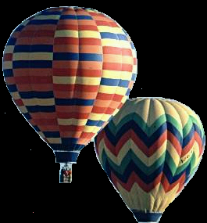
Charles’ Law
The Temperature-Volume Relationship

Slide 2
Charles’ Law
French chemist Jacques Charles discovered that the volume of a gas at constant pressure changes with temperature.
As the temperature of the gas increases, so does its volume, and as its temperature decreases, so does its volume.

Slide 3
C h a r l e s ’ L a w
The law says that at constant pressure, the volume of a fixed number of particles of gas is directly proportional to the absolute (Kelvin) temperature, mathematically expressed as:
V = kT

Slide 4
Charles’ Law
V = kT
V = Volume
k = Charles’ Law constant of Proportionality
T = Temperature in Kelvins

Slide 5
Explanation
Raising the temperature of a gas causes the gas to fill a greater volume as long as pressure remains constant.
Gases expand at a constant rate as temperature increases, and the rate of expansion is similar for all gases.

Slide 6
Example
If the temperature of a given amount of gas is doubled, for example, its volume will also double (as long as pressure remains unchanged).
2V = 2kT

Slide 7
Charles’ Law
Charles’ Law can be modified to a convenient form by solving for k.
k = V / T

Slide 8
Charles’ Law
In a sample with volume V₁ & temperature T₁, changing either volume or temperature converts these variables to V₂ and T₂.
V₁ / T₁ = k = V₂ / T₂
Therefore:
V₁ T₂ = V₂ T₁

Slide 9
Demonstration of Charles’ Law

Slide 10
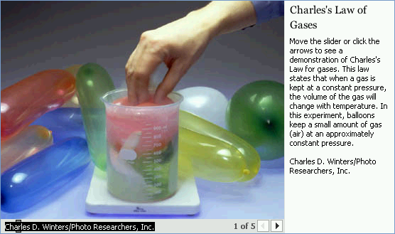
Charles’s law states that when a gas is kept at constant pressure, the volume of the gas will change with temperature.
In this experiment, balloons keep a small amount of gas (air) at an approximately constant pressure.

Slide 11
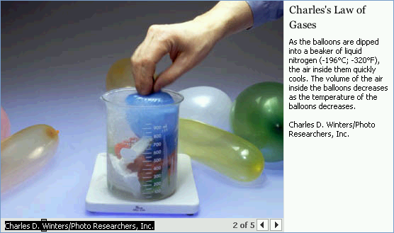
As the balloons are dipped into a beaker of liquid nitrogen (-196°C; -320°F), the air inside them quickly cools. The volume of the air inside the balloons decreases as the temperature of the balloons decreases.

Slide 12
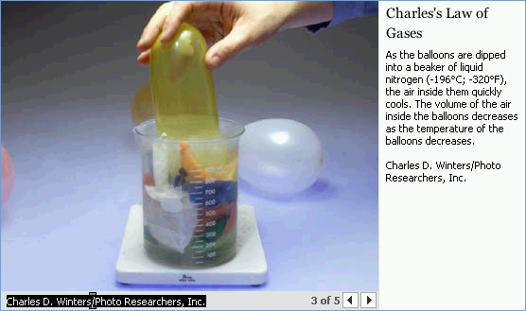
As the balloons are dipped into a beaker of liquid nitrogen (-196°C; -320°F), the air inside them quickly cools. The volume of the air inside the balloons decreases as the temperature of the balloons decreases.

Slide 13
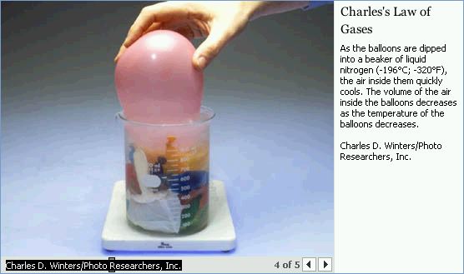
As the balloons are dipped into a beaker of liquid nitrogen (-196°C; -320°F), the air inside them quickly cools. The volume of the air inside the balloons decreases as the temperature of the balloons decreases.

Slide 14
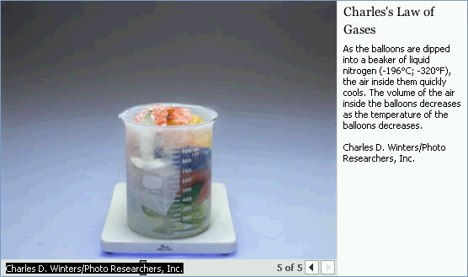
As the balloons are dipped into a beaker of liquid nitrogen (-196°C; -320°F), the air inside them quickly cools. The volume of the air inside the balloons decreases as the temperature of the balloons decreases.

Slide 15
Relationship of Boyle’s Law and Charles’ Law

Slide 16
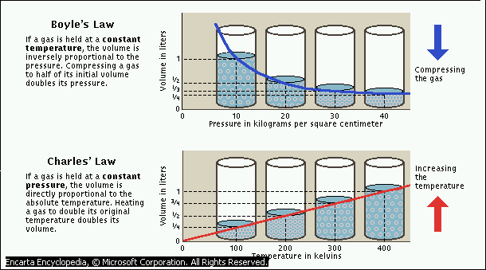
Pressuree in kilograms per square centimeter
Temperature in kelvins

Slide 17
Practical Applications

Slide 18
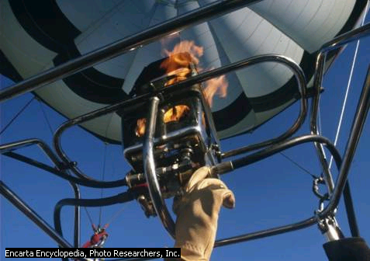
Hot AIR Balloon
The hot air that gives the hot-air balloon its name is commonly created by a propane gas burner that sends powerful jets of flame into the colorful rip-stop nylon envelope. Once the balloon is aloft, its height is maintained by opening and closing the blast valve, which controls the flow of the gas to the burner.

Slide 19
This powerpoint was kindly donated to www.worldofteaching.com
http://www.worldofteaching.com is home to over a thousand powerpoints submitted by teachers. This is a completely free site and requires no registration. Please visit and I hope it will help in your teaching.

